Slide 1
VIRTUAL “WHITEBOARD”
Final PRESENTATION
COMPUTER VISION
ARGENTINA ORTEGA SAINZ
NICOLAS LAVERDE ALFONSO
Jan. 15 2015

Slide 2
Introduction
Recognize the strokes made with a marker in a flat surface and to transform the strokes into drawings for later projection.
Two synchronized cameras capture snapshots simultaneously.
Process two snapshots from different perspectives to detect the position of a pre-defined marker.
Draw detected strokes and project them into a screen for visualization.

Slide 3
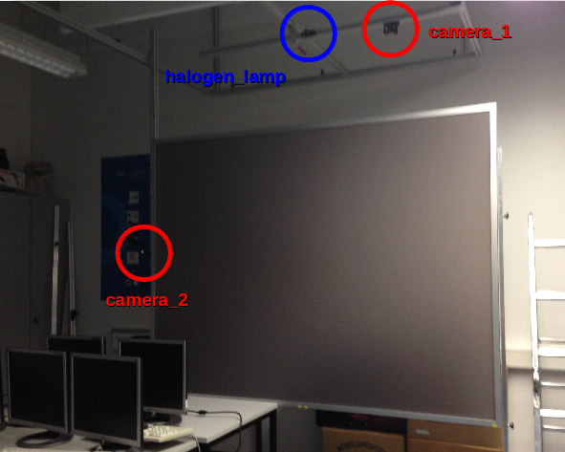
Description

Slide 4
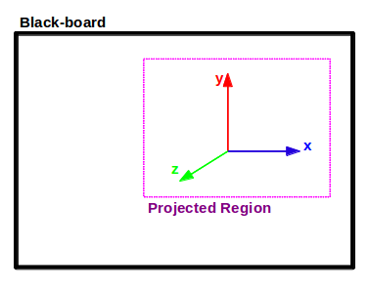
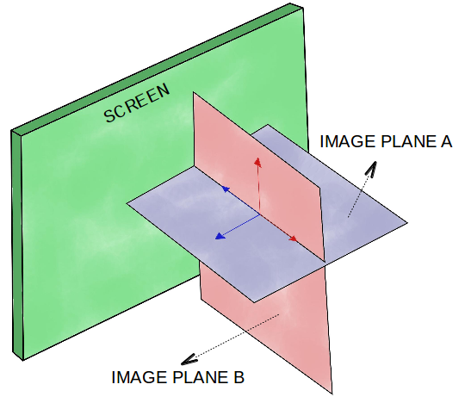
Description
Glass Screen
ROI

Slide 5
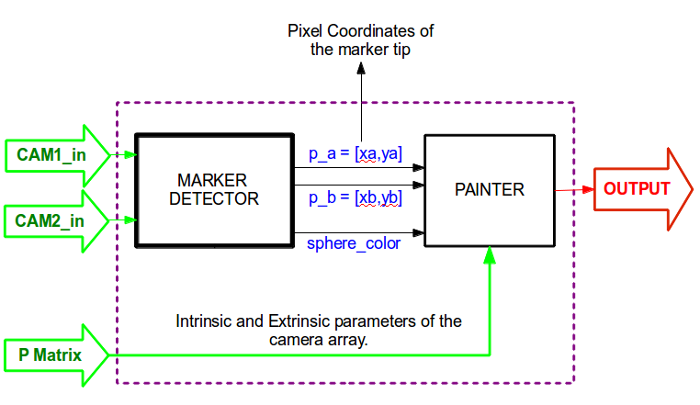
System Description

Slide 6
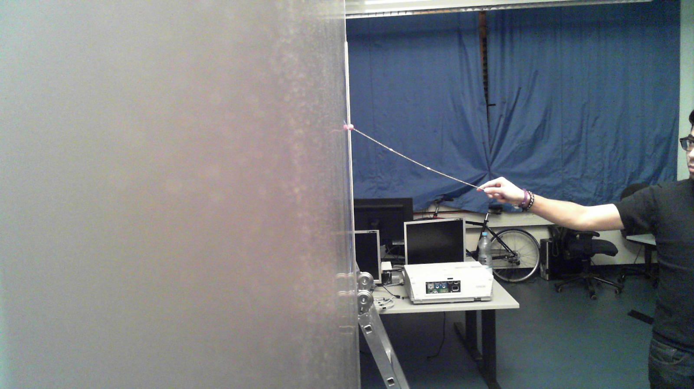
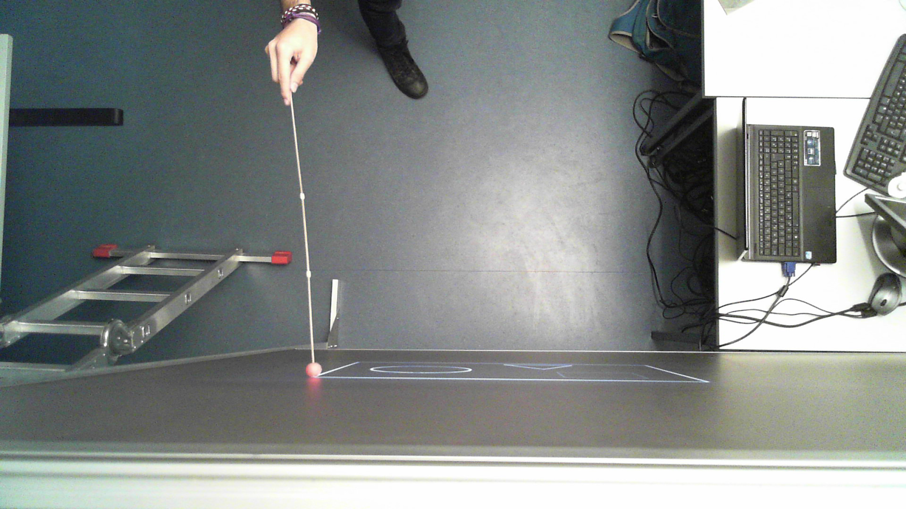
Input
Resolution: 1920x1080
OFFLINE DESIGN:
50-100 frames (images) per view.
3 sessions “recorded”, with three different colored markers (r,g,b).

Slide 7
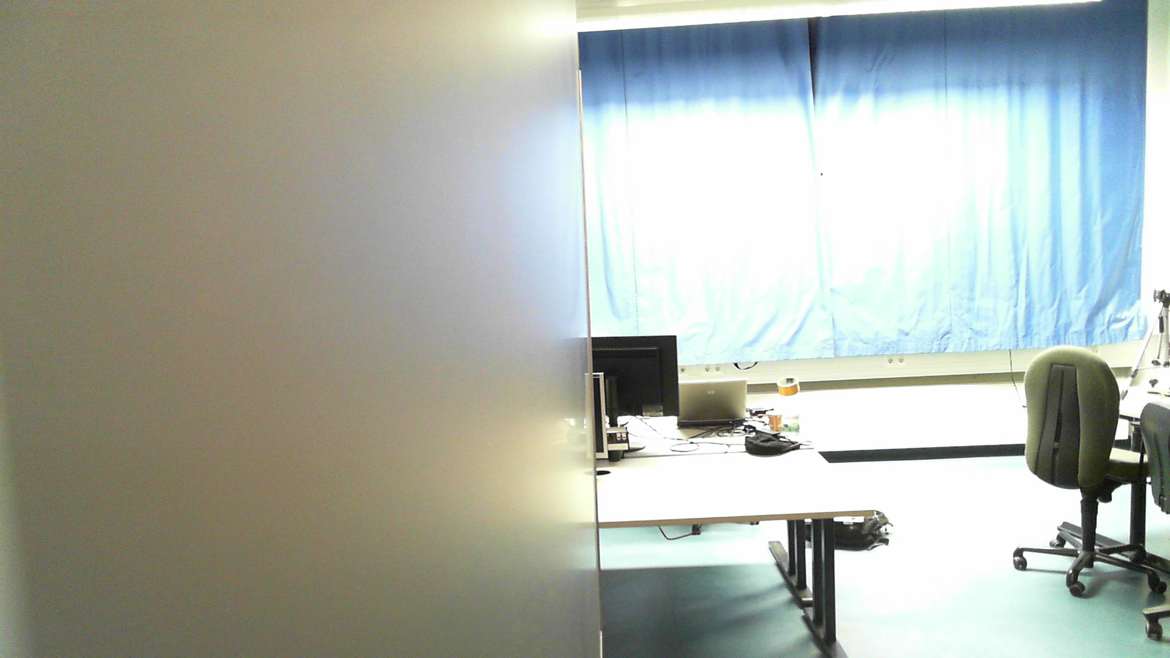
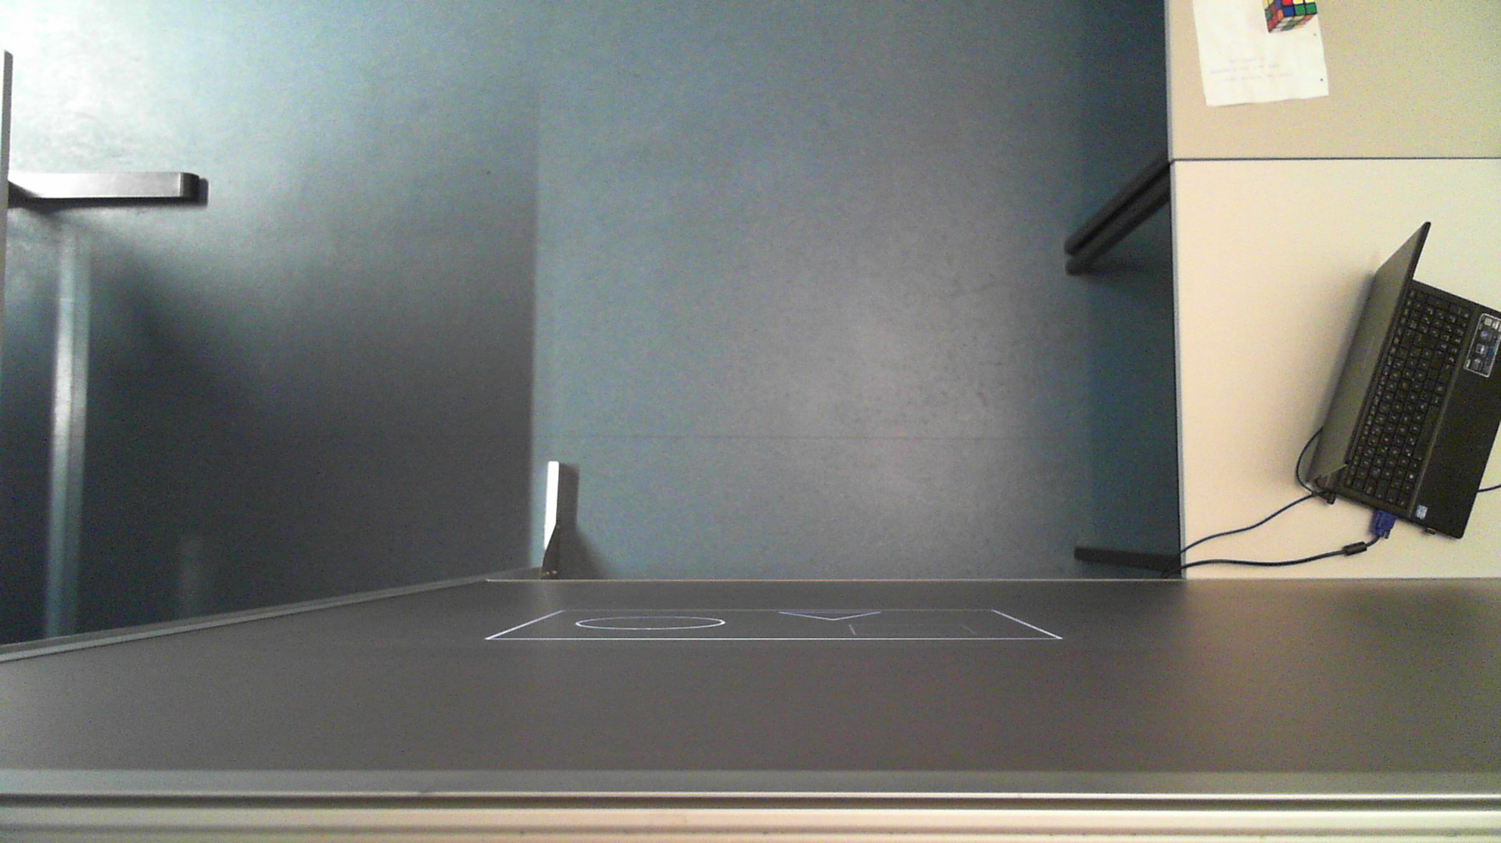
Calibration
Background

Slide 8
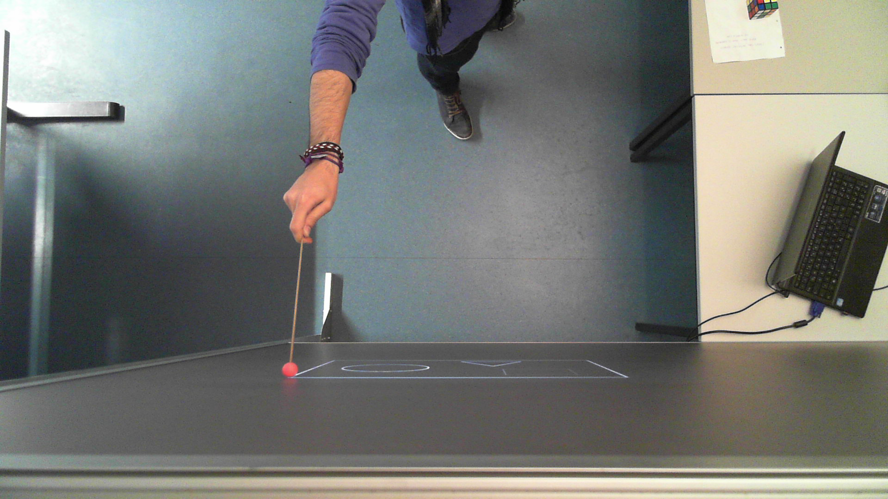
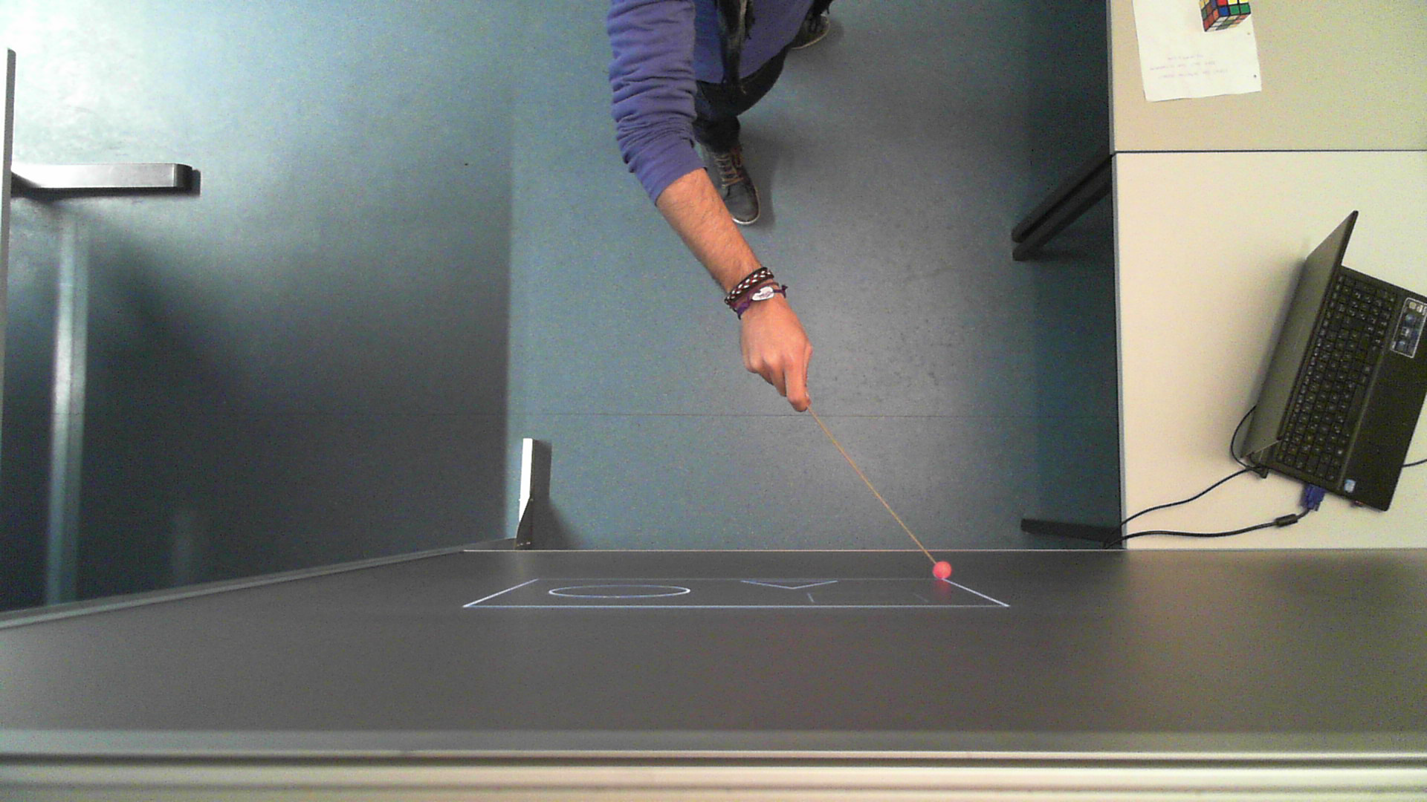
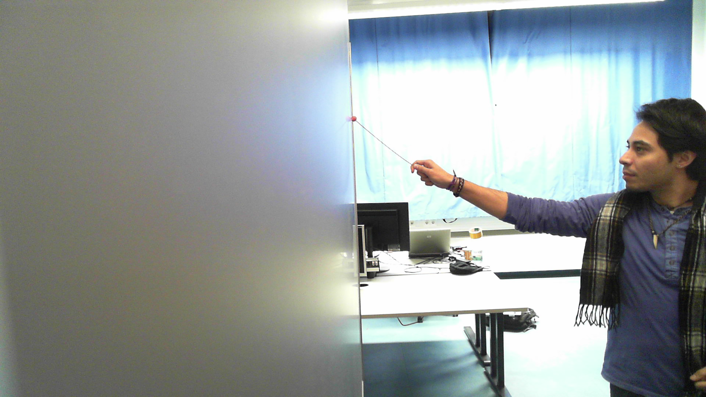
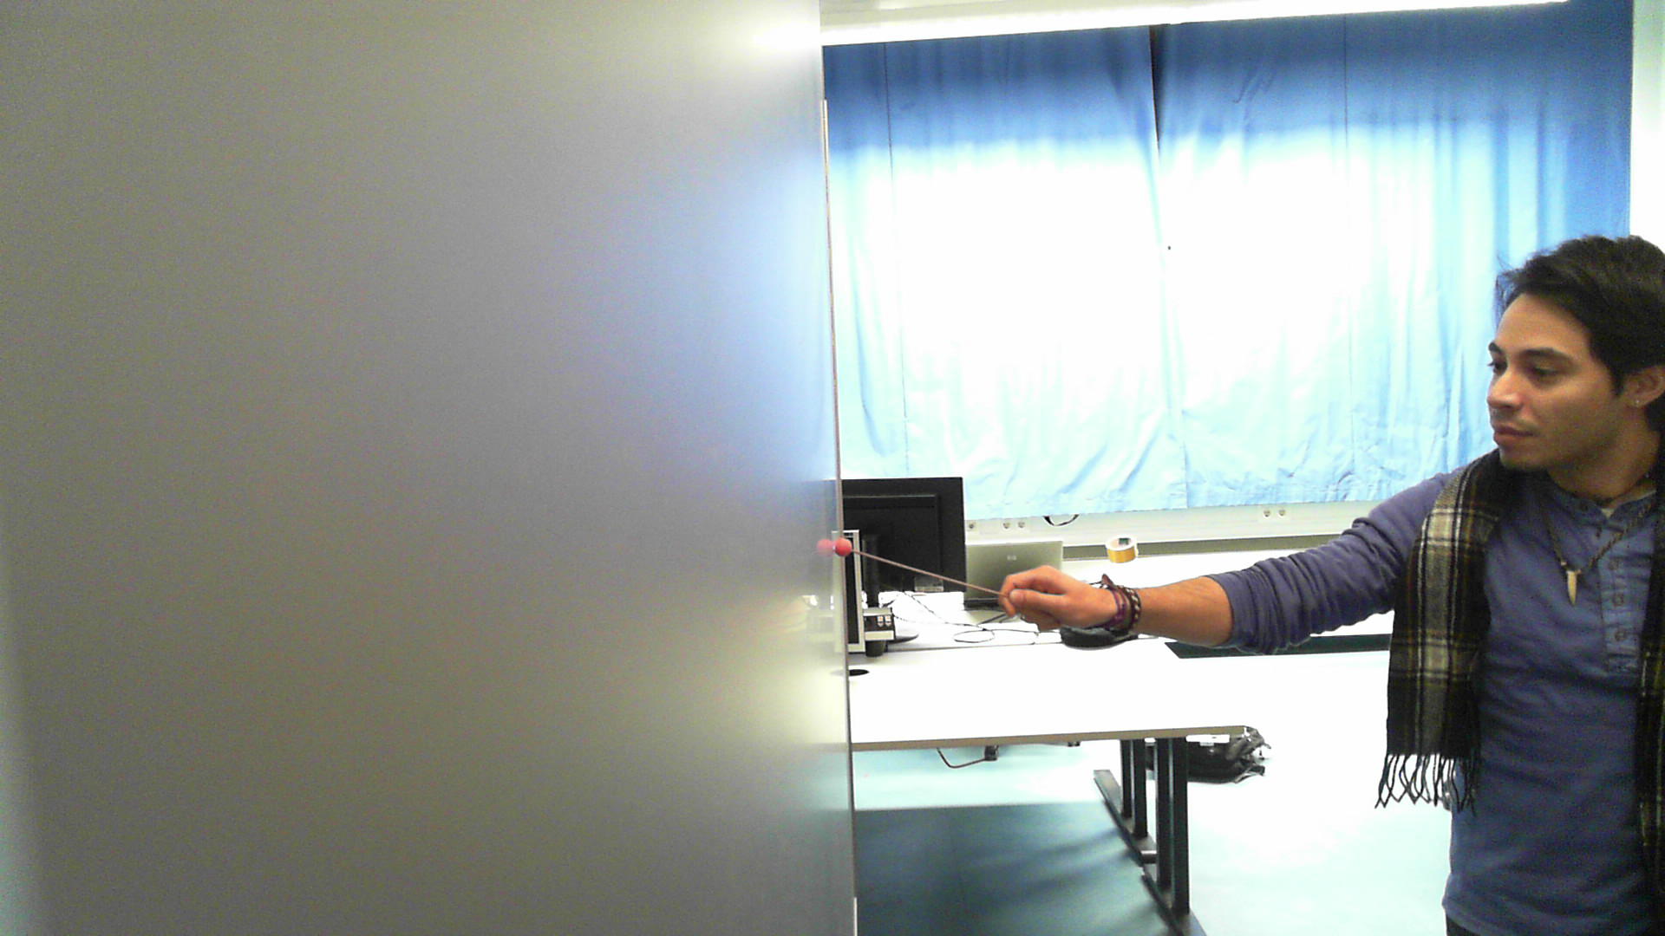
Calibration
Corners

Slide 9
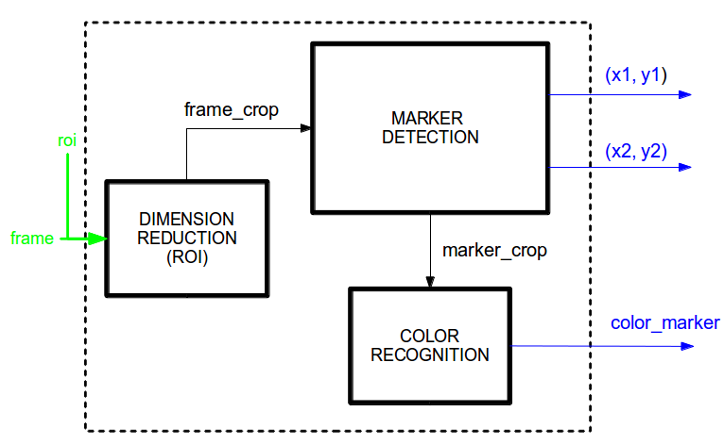
Marker Detector System

Slide 10
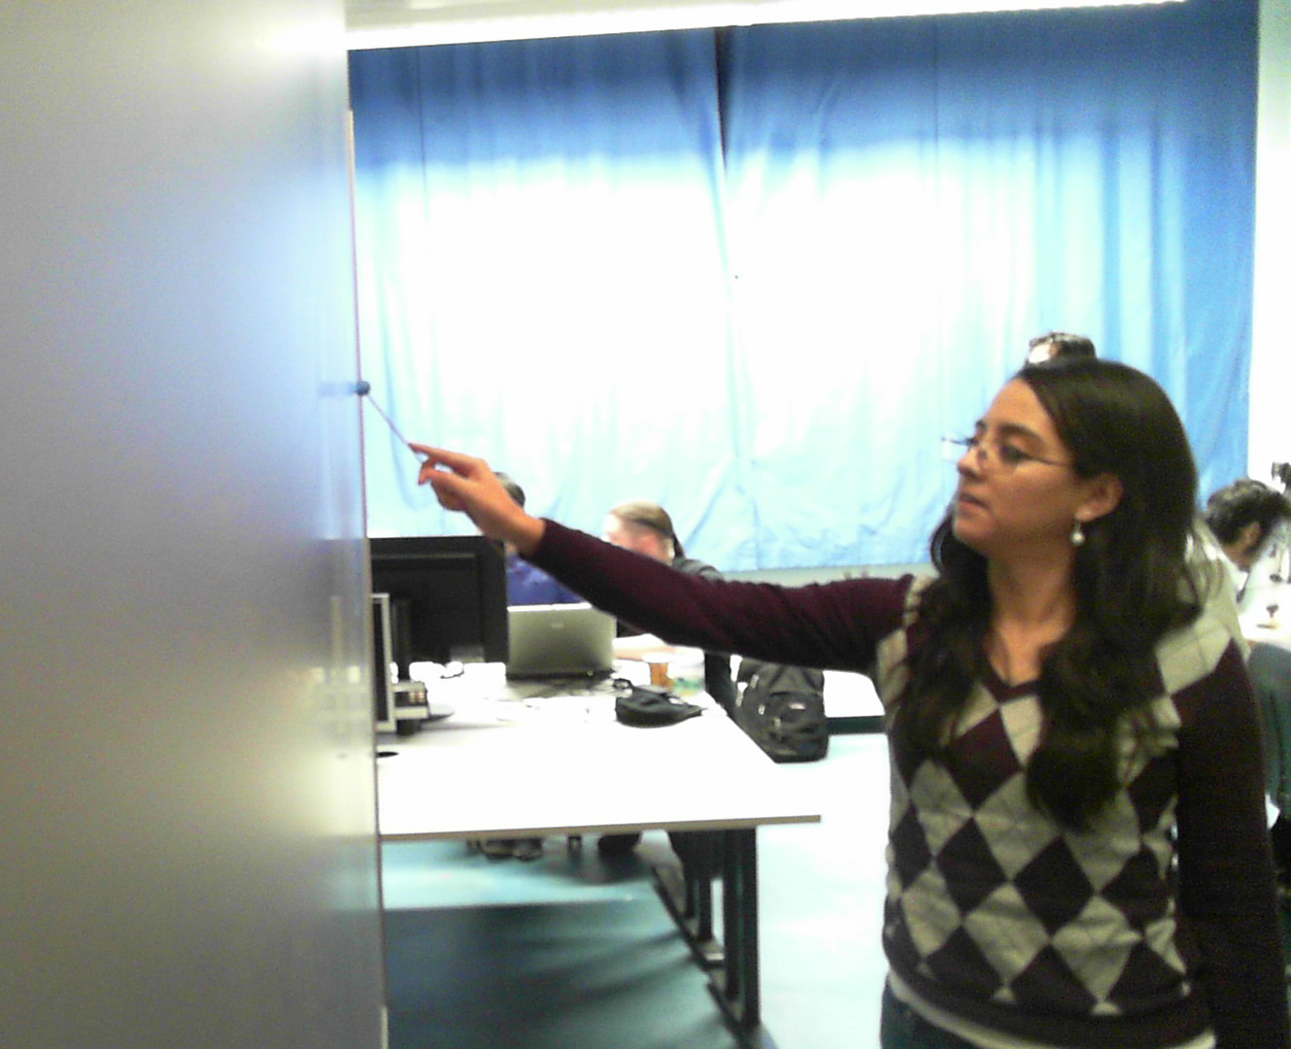
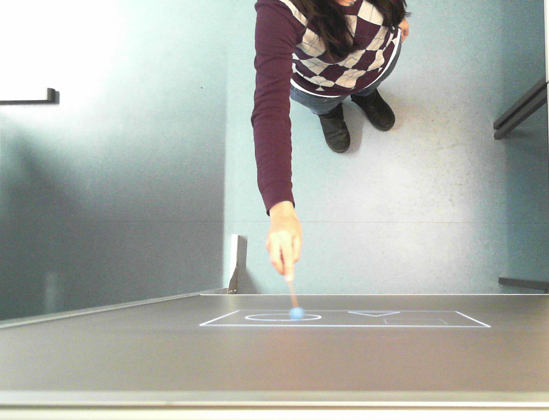
Results
Data Synchronization

Slide 11
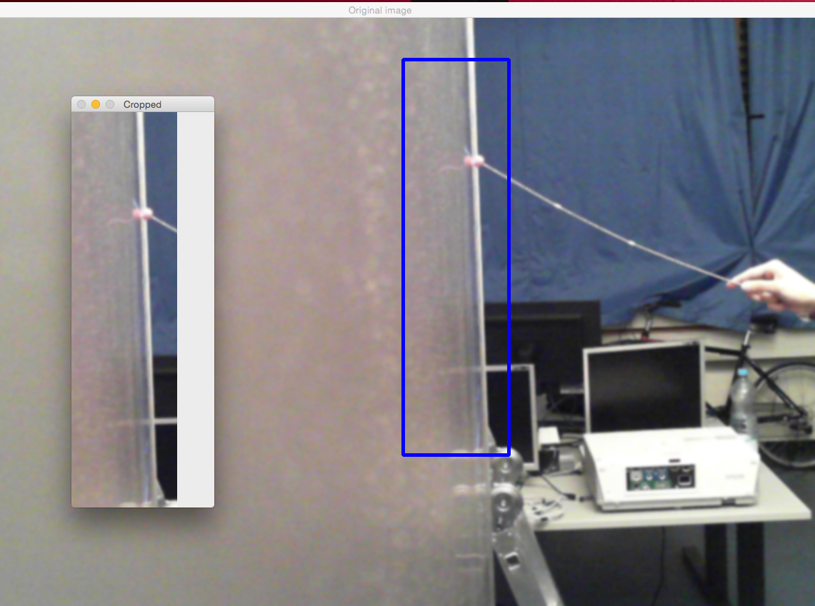
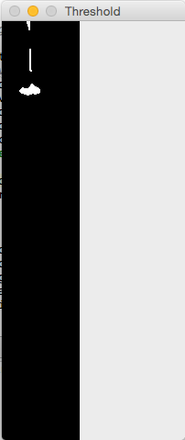
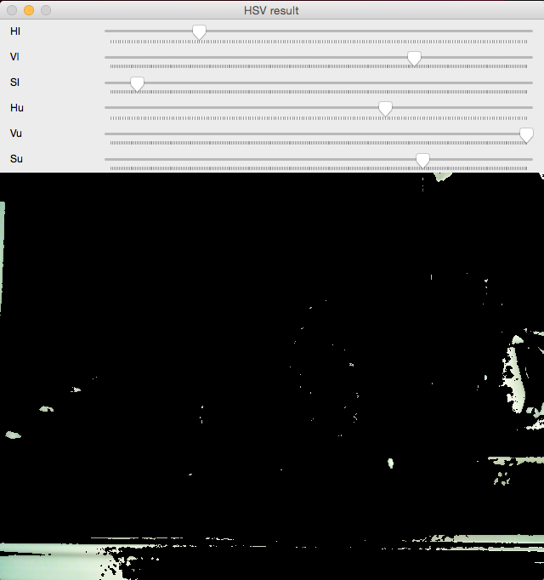
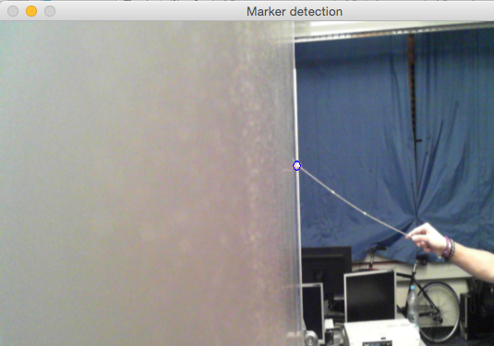
Marker Detection
Color Threshold
+
+
=

Slide 12
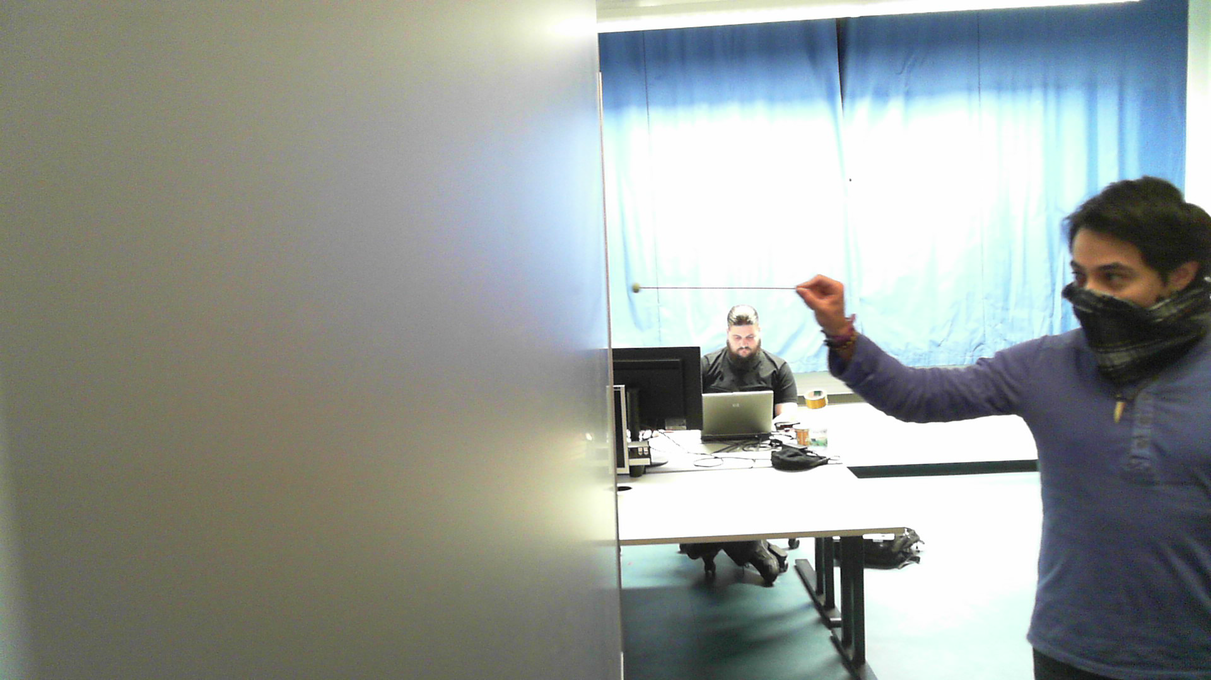
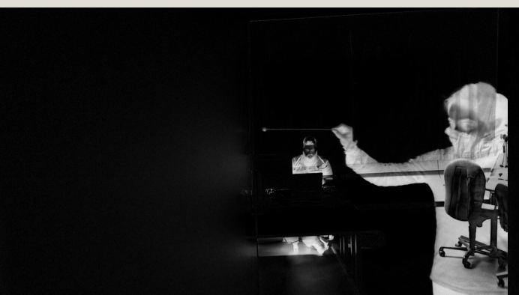
Marker Detection
Background Difference

Slide 13
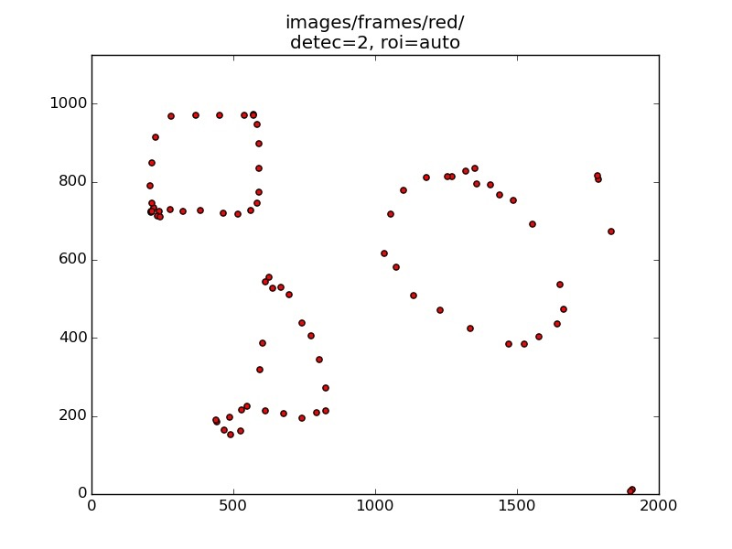
Results

Slide 14
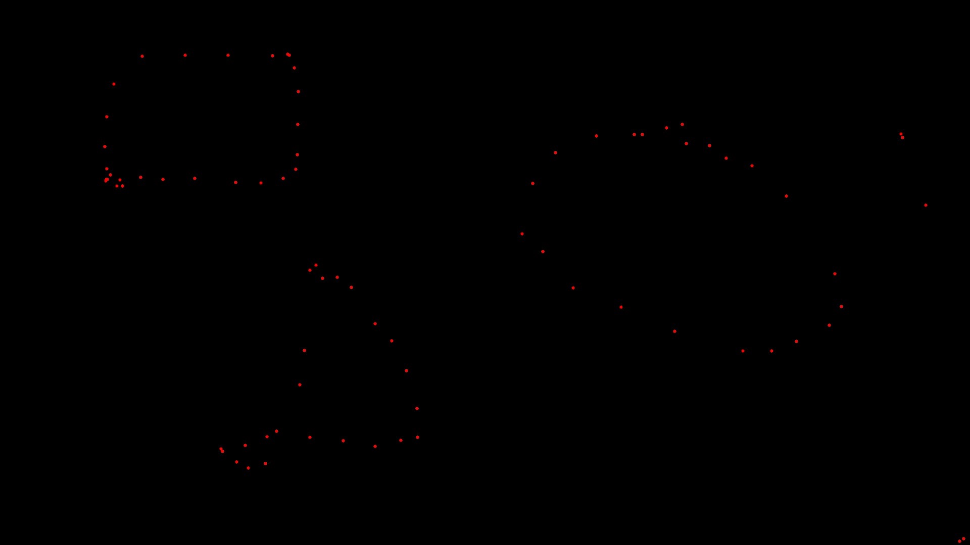
Results
(Board Output)

Slide 15
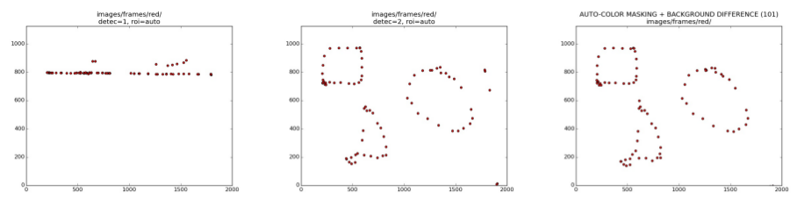
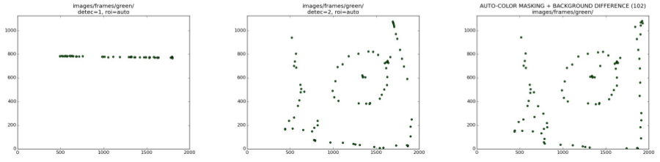
Results
(Approach Comparison)

Slide 16
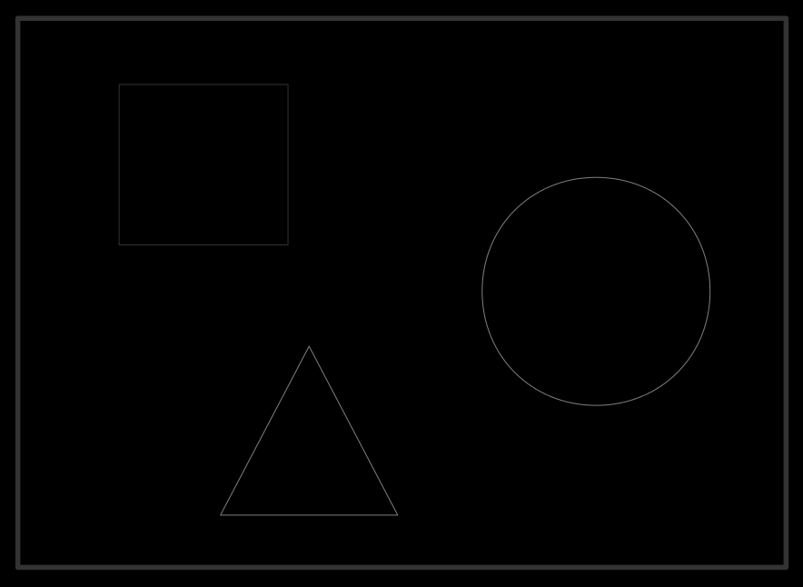
EVALUATION
(Guideline)
Delay
Accuracy
Detections

Slide 17
EVALUATION
(Guideline → Accuracy)

Slide 18
Task Distribution
Data capture [Argentina].
Marker detection (color mask) [Argentina].
Marker detection (background segmentation) [Nicolas].
Color recognition [Argentina].
Marker pixel coordinates [Nicolas].
Position reconstruction [Nicolas].
Point re-projection [Argentina].

